Slide 1
PLEASE GRAB 1 SHEET OF PAPER
YOUR PAPER DOESN’T NEED TO BE WHITE
IN FACT YOU MIGHT BE BETTER OFF IF YOURS ISN’T
HARD TO KNOW -- WHAT WILL YOU CHOOSE?

Slide 2
What is Copyright?
This is Not a Lecture on AI
(or is it?)
Heather R. VanDyke
Javelina Legal

Slide 3
What is Copyright?
A short term monopoly for certain original works of human authorship fixed in a tangible medium of expression
Ok, we answered the question. Thank you for your time today.

Slide 4
Well, wait a minute…
What if we ask what IS copyright?
The way to answer this question is to embody the concepts.

Slide 5
Why embody these concepts?
Knowing the terminology alone isn’t enough
Technology continues to evolve and so lawyers need to as well
Experience with the areas you advise on will give you a deeper connection to the material and your client
Immersive, experiential, innovation –these buzz words are all the rage so lawyers should get in on the action too ;)

Slide 6
How do we embody copyright?
Review Copyright Basics
Make Some Art
See How that Feels
Ask (and maybe answer): does that experience change the answer to “What is Copyright?”

Slide 7
What is Copyright?
Copyright is the legal protection of certain types of works of human authorship for a limited duration
Copyright is different than trademark and patent, which are other types of “intellectual property”
Intellectual property is an intangible asset – you can’t touch it like a car – but it has tremendous value
U.S. Copyright Law: Title 17

Slide 8
Origins of the Copyright Act: U.S. Constitution
Congress shall have the power…
“to promote the progress of science and useful arts, by securing for limited time to authors and inventors the exclusive right to their respective writings and discoveries.”
Article 1, Section 8, clause 8, United States Constitution

Slide 9
U.S. Framework for Copyrightability
Is the work eligible for copyright protection in the U.S.?
Published or unpublished in U.S.
Unpublished foreign
Has the work been fixed in a tangible medium of expression?
Permanent, stable, can be perceived, reproduced or communicated
Was the work created by a human author?
Not: photo taken by a monkey, mural painted by an elephant, driftwood shaped by the ocean, defects found in natural stone, works produced by a machine or mere mechanical process
Does the work constitute copyrightable subject matter?
Is the work sufficiently original?
Independently created and creative
Was the work independently created?
Not copied
Does the work possess some minimal degree of creativity?
Low threshold
Literary works, musical works (+words), dramatic words (+music), pantomimes / choreographic works, pictorial / graphic / sculptural works, motion pictures / AV works, sound recordings, architectural works

Slide 10
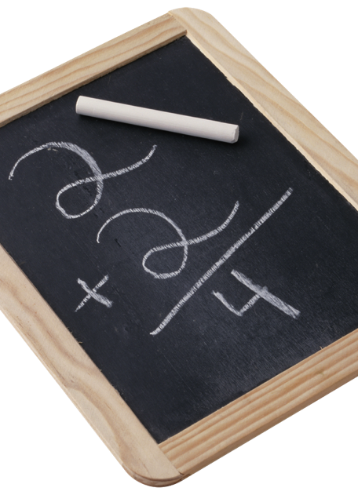
Not Copyrightable
Words or short phrases
Facts
Ideas or concepts
Methods of operation, processes, or systems
Common shapes or symbols
Trademarks
Works created by the government

Slide 11
Bundle of Rights
Copyright Owner’s Bundle of Exclusive Rights:
Reproduce the work
Prepare derivative works
Publicly distribute copies
Publicly perform
Publicly display
Notes:
when the artwork is embodied in a tangible form that is perceptible by the human senses either directly or with the aid of a machine
capable of being reproduced
Examples: computer files, cds, canvas, paper, or any other physical recording of the expression

Slide 12
Copyright Notice & Registration
© 2024 Heather R. VanDyke
Affix to work immediately upon fixation to let people know who owns the rights to the work
However, notice is not required on works published after March 1, 1989
Benefits of Registration:
Statutory Damages Determined by court - increased if willful
Attorneys’ Fees
Copyright Database
Evidence of ownership
Licensing opportunities

Slide 13
Prompt #1
Close your eyes, picture your family room in your current home or where you grew up. What is one object that stands out?
Draw that object in 1 minute

Slide 14
Fold your paper any way you’d like
And we will all pass it 4 times in the direction I tell you and all at the same time

Slide 15
Review the paper in your hands
1. Has the work been fixed in a tangible medium of expression?
2. Was the work created by a human author?
3. Does the work constitute copyrightable subject matter?
4. Is the work sufficiently original?
5. Was the work independently created?
6. Does the work possess at least some minimal degree of creativity?

Slide 16
If you answer “no” to any of the Qs
Add an “X” in any design format you choose: on, around, over, under, in the corner, big small, etc. on the paper

Slide 17
How did ChatGPT Answer the Prompt? 2 Different Answers when asked:

Slide 18
Real Property vs. Intellectual Property
First Sale Doctrine: 17 U.S.C. S. 109
an individual who purchases a copy of a copyrighted work from the copyright holder receives the right to sell, display or otherwise dispose of that particular copy but not the underlying copyright
The sale of a physical object does not constitute the sale of the underlying copyright

Slide 19
Duration of Copyright Protection
1909 Act
28 years + 28 years
Works originally copyrighted after 1922 and renewed before 1978
Automatically extended to a term of 95 years
Lesser of 95 years from publication or 120 years from creation
Works created on or after January 1, 1978
Life of the author + 70 years
Works Made for Hire:
Publication = 1+ copies of the work are distributed to the public w/ authority of the copyright owner

Slide 20
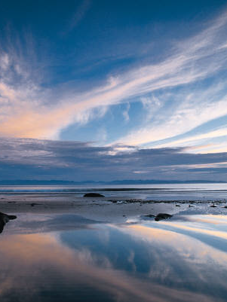
Public Domain
Copyright lapsed, never protected
Public Domain materials can be freely used
Works published before January 1, 1928

Slide 21
Prompt #2
What is your fondest memory so far as a law student or attorney?
Depict it in a drawing or short writing on the paper in front of you. You have 1 minute.

Slide 22
Tear your paper any way you’d like
Small tears, big ones, reducing the overall size, one tear, many tears, etc.
And we will all pass it 4 times in the direction I tell you and all at the same time

Slide 23
Review the paper in your hands
If your paper is blue, the work you are viewing is in the public domain. It is currently available for use in any manner. In the future, if there is copyrightable content combined with the existing work, then those components of the work may be protectible. Add the letters PD in close proximity to the existing images.
If your paper isn’t blue, do you agree with the current assessment as to whether it is copyrightable (e.g., whether the “X” or no “X” is appropriate?). If you think an “X” is missing, add one. If you think it’s there in error, remove it however you’d like (color over it, smudge it out, rip it off, etc.).

Slide 24
How did ChatGPT Answer the Prompt?

Slide 25
Using Third Party Content
Copying images, lyrics, or other third-party content in your work may be copyright infringement
Typically it is safest to publish you work with the permission of the original author
Note: asking for but being denied permission is likely worse than using without permission

Slide 26
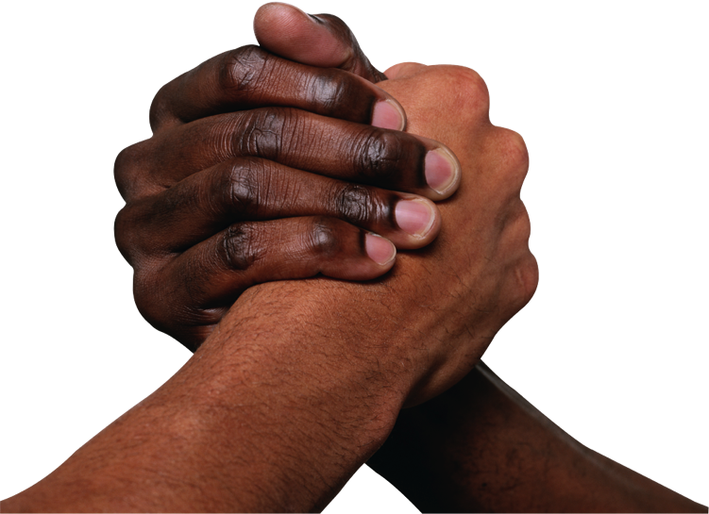
Joint Works
Joint authors can each exploit a work
Must account to joint authors
Establishing joint ownership
Intent to contribute to the whole
Contributions are separately copyrightable
To prevent joint authorship
Written agreement setting forth terms of the relationship
Notes:
Gaiman v. McFarlane

Slide 27
Prompt #3
What month were you born?
Draw a representation of that month (e.g., zodiac sign, season, personal reference, write the name of the month, etc.). You have 1 minute.

Slide 28
Add several small shapes throughout your paper
Circles, squares, rectangles, oblong shapes
And we will all pass it 4 times in the direction I tell you and all at the same time

Slide 29
Review the paper in your hands
If your paper is pink, there is a written agreement amongst the existing joint authors that states one author is able to license the entire work on behalf of all authors. Choose which author has licensing authority by encircling the portion of the work that is clearly created by one author. If one author isn’t distinct, then change nothing.
If your paper isn’t pink, your joint work does not have an existing agreement and all authors must agree on licensing terms.

Slide 30
How did ChatGPT Answer the Prompt?

Slide 31
Works Made for Hire
The creator does not own the rights to a work for hire
Work for hire exists if:
Employee + work created in scope of employment; or
Control by the employer over the work
Control by the employer over the employee
Work ordered/commissioned + agreed in writing
Contribution to collective work
Contribution to audio-visual work
Translations
Supplementary work
Compilation
Instructional text
An atlas
Duration of protection based on publication or creation
A WFH cannot be terminated under the Copyright Act
Notes:
Termination rights do not apply to works for hire

Slide 32
Copyright License & Assignment
License
Shorter term duration
Licensor retains ownership of underlying rights
Assignment
Transfer all or part of the rights in the copyright
Can be for the life of the copyright or for a shorter duration

Slide 33
Prompt #4
What is your favorite color and where have you seen it? Depict that scene. You have 1 minute ☺

Slide 34
Draw a line on your paper
Anywhere. Long, short, dark, light, more than one or one
And we will all pass it 4 times in the direction I tell you and all at the same time

Slide 35
Review the paper in your hands
Take a picture of the work and send it to your parent, sibling, partner, or friend – has it now been published? Did you have permission?
A print publication has requested a license for all works. Some are partially in the public domain, some are joint works with multiple authors and some have a written agreement. How would your work be licensed and what is the duration of protection?
Remember:
Blue: Public domain, but only the images with PD next to them
Pink: written agreement between the parties designating one author as the licensor
If your paper is yellow: it is a work for hire owned by the commissioner of the work

Slide 36
How did ChatGPT Answer the Prompt?

Slide 37
Fair Use: -Affirmative defense to copyright infringement
-It’s not fair use until a judge says so!
Four factors: Balancing test
1. Purpose/character of the use
Commercial?
Educational?
Transformative?
2. Nature of the copyrighted work
Fiction?
Non-fiction?
3. Amount used in relation to work as a whole
Was the heart of the work used?
4. Effect on the market for the original
Does the new work replace the original in the marketplace?

Slide 38
Transformative Use
Transformative use – first factor – whether the new work supersedes the objects of the original creation or instead adds something new, with a further purpose and character
Goldsmith v. Warhol: P’s photo used for commercial purposes by
Opinion: “original works, like those of other photographers, are entitled to copyright protection, even against famous artists”
Justice Kagan’s dissent: the decision “… will stifle creativity of every sort. It will impede new art and music and literature. It will thwart the expression of new ideas and the attainment of new knowledge. It will make our world poorer.”

Slide 39
Prompt #5
What is your favorite piece of music, and if you had endless creative talent, what would it inspire you to create? Draw it, write it, reference it. You have 1 minute.

Slide 40
Add a copyright notice to the bottom right of your page:
© 2024 ________ (what will you put in the blank? If unsure just leave it blank)
Pass all papers to the right to the end of the row and I will collect

Slide 41
How did ChatGPT Answer the Prompt?

Slide 42
I now have all of your creations
My plan is to use your work however I want! Lol.
For real, I would like to display your work in some manner, format, arrangement. There may be paint added to what you’ve made, further deconstruction, illustration.
I don’t know who made what. I have the key we created together, but I don’t have all of your names. Can I do this? Should I? What is the copyright duration of the work?

Slide 43
What’s the Point?
You now know / are reminded of:
Copyright basics
What it feels like to create your own original work of authorship – dare we say art?
The element of humanness contributing to the creation
Personal preferences
Feelings
Experiences
Consciousness
Experiencing time
Memories
As humans, embodiment gives us a leg up over mechanical, technical, process-focused, data-driven innovations
The current limitations in ChatGPT’s abilities
See GW Law searchable database of pending AI litigation https://blogs.gwu.edu/law-eti/ai-litigation-database/
The challenges of determining copyright ownership

Slide 44
Now that you have embodied it…
What is Copyright?

Slide 45
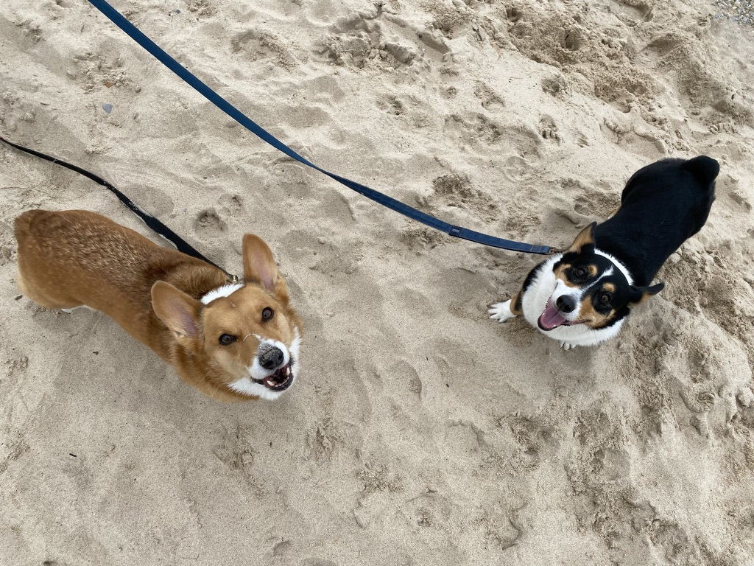
Reach out with Qs / Comments
Heather R. VanDyke
heather@javelinalegal.com
Thank you!

